Slide 1
3. The Realities of Software Testing
♦Unfortunately, in the real world you will never see a project perfectly follow any of the development models.
♦ You will never be given a thoroughly detailed specification that perfectly meets the customer's needs and
♦ you will never have enough time to do all the testing you need to do.
♦ But, to be an effective software tester, you need to understand what the ideal process is so that you have something to aim for.
School of Software Engineering of South China University of Technology LiuGuixi

Slide 2
3. The Realities of Software Testing
Why software can never be perfect
Why software testing isn't just a technical problem
The terms commonly used by software testers
School of Software Engineering of South China University of Technology LiuGuixi

Slide 3
The Realities of Software Testing
♦ (1) It's Impossible to Test a Program Completely
♦ (2) Software Testing Is a Risk-Based Exercise
♦ (3) Testing Can't Show That Bugs Don't Exist
♦ (4) The More Bugs You Find, the More Bugs There Are
♦ (5) The Pesticide Paradox
School of Software Engineering of South China University of Technology LiuGuixi

Slide 4
The Realities of Software Testing
♦ (6) Not All the Bugs You Find Will Be Fixed
♦ (7) When a Bug's a Bug Is Difficult to Say
♦ (8) Product Specifications Are Never Final
♦ (9) Software Testers Aren't the Most Popular Members of a Project Team
♦ (10) Software Testing Is a Disciplined Technical Profession
School of Software Engineering of South China University of Technology LiuGuixi

Slide 5
（1）It's Impossible to Test a Program Completely
The number of possible inputs is very large.
The number of possible outputs is very large.
The number of paths through the software is very large.
The software specification is subjective.
You might say that a bug is in the eye of the beholder(旁观者).
School of Software Engineering of South China University of Technology LiuGuixi

Slide 6
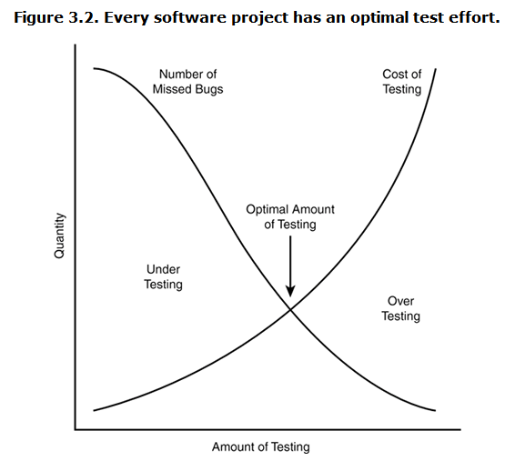
（2）Software Testing Is a Risk-Based Exercise
School of Software Engineering of South China University of Technology LiuGuixi

Slide 7
Software Testing Is a Risk-Based Exercise
One key concept that software testers need to learn is
♦ how to reduce the huge domain of possible tests into a manageable set,
♦ and how to make wise risk-based decisions on what's important to test and what's not.
School of Software Engineering of South China University of Technology LiuGuixi

Slide 8
（3） Testing Can't Show That Bugs Don't Exist
♦ You can perform your tests, find and report bugs,
♦ but at no point can you guarantee that there are no longer any bugs to find.
♦ You can only continue your testing and possibly find more.
School of Software Engineering of South China University of Technology LiuGuixi

Slide 9
（4）The More Bugs You Find, the More Bugs There Are
Programmers have bad days.
Programmers often make the same mistake.
Some bugs are really just the tip of the iceberg.
School of Software Engineering of South China University of Technology LiuGuixi

Slide 10
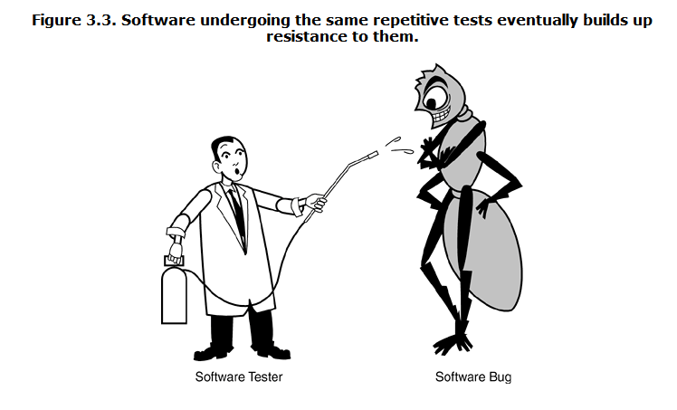
（5）The Pesticide Paradox
School of Software Engineering of South China University of Technology LiuGuixi

Slide 11
（6）Not All the Bugs You Find Will Be Fixed
There's not enough time.
It's really not a bug.
It's too risky to fix.
It's just not worth it.
The decision-making process usually involves the software testers, the project managers, and the programmers.
School of Software Engineering of South China University of Technology LiuGuixi

Slide 12
（7）When a Bug's a Bug Is Difficult to Say
The software doesn't do something that the product specification says it should do.
The software does something that the product specification says it shouldn't do.
The software does something that the product specification doesn't mention.
The software doesn't do something that the product specification doesn't mention but should.
The software is difficult to understand, hard to use, slow, or in the software tester's eyes will be viewed by the end user as just plain not right.
School of Software Engineering of South China University of Technology LiuGuixi

Slide 13
（8）Product Specifications Are Never Final
As a software tester, you must assume that the spec will change. Features will be added that you didn't plan to test. Features will be changed or even deleted that you had already tested and reported bugs on. It will happen.
School of Software Engineering of South China University of Technology LiuGuixi

Slide 14
（9）Software Testers Aren't the Most Popular Members of a Project Team
——The goal of a software tester is to find bugs, find them as early as possible, and make sure they get fixed.
Your job is to inspect and critique your peer's work, find problems with it, and publicize what you've found. Ouch! You won't win a popularity contest doing this job.
1、Find bugs early.
2、Temper your enthusiasm.
3、Don't just report bad news.
School of Software Engineering of South China University of Technology LiuGuixi

Slide 15
（10）Software Testing Is a Disciplined Technical Profession
This is great news if you're interested in software testing.
It can now be a career choice a job that requires training and discipline, and allows for advancement.
School of Software Engineering of South China University of Technology LiuGuixi

Slide 16
SQA's relationship to software testing
SQA is the management work, the review object is the process, and the emphasis is on prevention
The test is the technical work, the test object is the product, mainly is the post-inspection
SQA directs testing and monitors testing
Testing provides the basis for SQA
School of Software Engineering of South China University of Technology LiuGuixi

